Slide 1

Airline management system
YASH PATEL
NISARG PATEL
NIRALEE HIRPARA
HARSH SHAH

Slide 2

What is an Airline Management System?
An Airline Management System is a comprehensive software platform designed to streamline and optimize an airline's operations. It manages various key aspects, including flight schedules, ticket bookings, customer data, boarding passes, journey details, and cancellations. Integrating these functionalities into a unified system enhances operational efficiency, improves customer experience, and reduces errors.
Overview of its purpose: improving efficiency, customer satisfaction, and operational management.

Slide 3

Flight Information
Features:
Search for flights by date, destination, and airline.
Real-time updates on flight schedules and availability.
Benefits: Improved accuracy and decision-making for customers and staff.

Slide 4
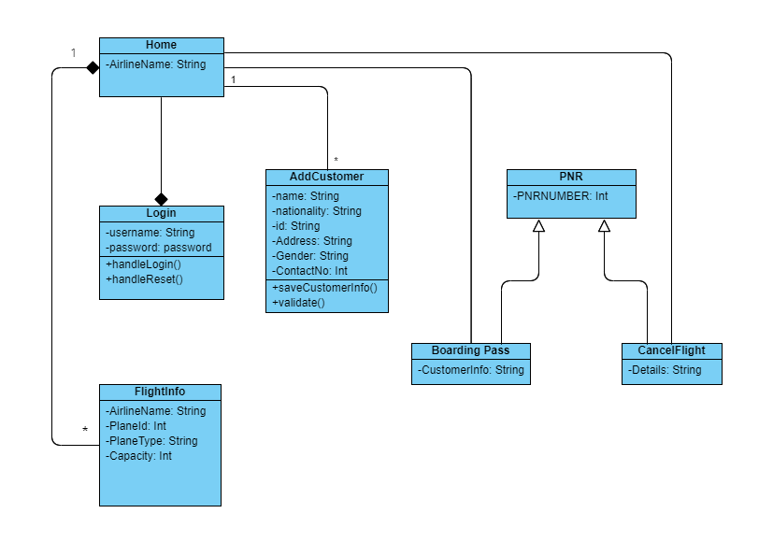
Class DIAGRAM

Slide 5
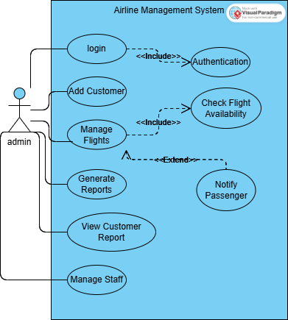
Use Case DIAGRAM

Slide 6
Boarding Pass
Automated boarding pass generation upon ticket booking.
Features: QR codes, seat assignments, and flight details.
Benefit: Streamlined boarding process.

Slide 7

Add Customer
Features:
Add new customers with personal and contact details.
Securely store customer information for future bookings.
Benefit:
Enhanced customer experience and retention

Slide 8

Journey Information
Includes:
Route details (origin and destination).
Stopovers and layovers information.
Estimated travel time.
Benefits: Transparent journey planning for customers.

Slide 9
Flight Booking Module
Features:
Select flights based on customer preferences.
Secure payment options.
Benefit:
Simplifies the ticketing process for travellers.

Slide 10

Flight Cancellation Module
Features:
Easy cancellation process with a refund system.
Customer notification through email or SMS.
Benefit:
Improved flexibility and trust.

Slide 11
Why Use an Airline Management System?
Efficient management of flights, customers, and bookings.
Enhanced customer experience.
Reduced errors and operational costs.

Slide 12

Conclusion and Future Scope
Future enhancements:
Integration with AI for predictive analysis.
Mobile app for customer convenience.
Closing statement emphasizing the importance of the system in modern airline operations.

Slide 13

THANK YOU

